Slide 1

CHATBOT DEPLOYMENT WITH IBM CLOUD WATSON ASSISTENT
PRESENTED by
M. YUVARAJ

Slide 2

INTRODUCTION
Welcome to the presentation on Streamlining Chatbot Deployment with IBM Cloud Watson Assistant and IBM Container Registry. In this session, we will explore how these powerful tools can help businesses enhance their Chatbot capabilities and streamline the deployment process.

Slide 3
WHY CHATBOT MATTER
Chatbots have become an essential part of customer service, providing instant and personalized assistance. However, deploying and managing chatbots can be complex. IBM Cloud Watson Assistant and IBM Container Registry offer a comprehensive solution to simplify the process, enabling businesses to deliver efficient and seamless chatbot experiences.

Slide 4
UNDERSTANDING IBM CLOUD WATSON ASSISTENT
IBM Cloud Watson Assistant is an AI-powered chatbot platform that allows businesses to build, train, and deploy chatbots across multiple channels. It leverages natural language processing and machine learning to understand user queries and provide accurate responses, making it an ideal choice for businesses looking to enhance their customer support capabilities.

Slide 5
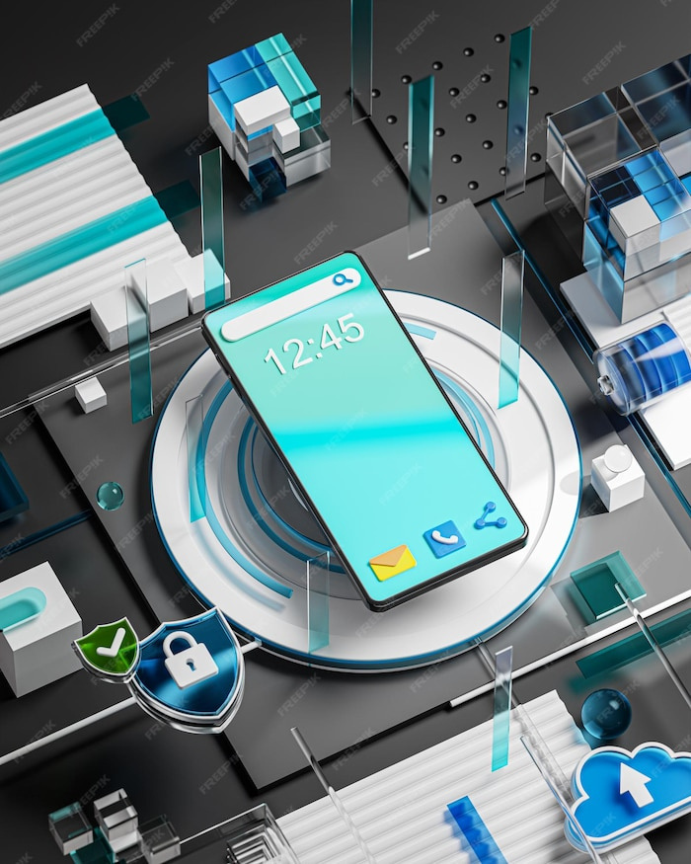
Leveraging IBM Container Registry
To ensure seamless deployment and scalability of chatbots, IBM Container Registry provides a secure and reliable platform. It allows businesses to store, manage, and deploy containerized chatbot applications, enabling effortless scalability and reducing infrastructure complexities.

Slide 6
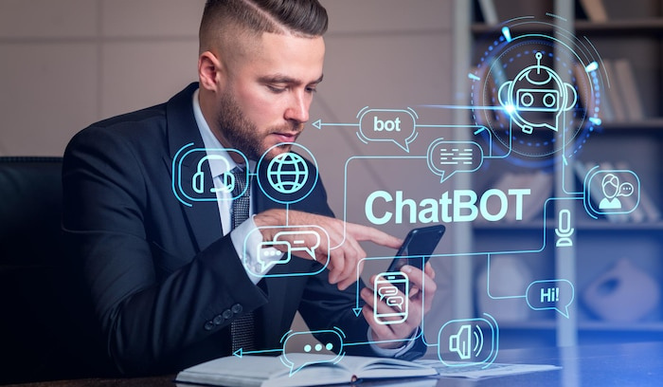
IBM CONTAINER REGISTRY
With IBM Cloud Watson Assistant and IBM Container Registry, the chatbot deployment process is streamlined. From building and training the chatbot using Watson Assistant to containerizing the application and deploying it using Container Registry, businesses can achieve faster time-to-market and efficiently manage their chatbot infrastructure.

Slide 7
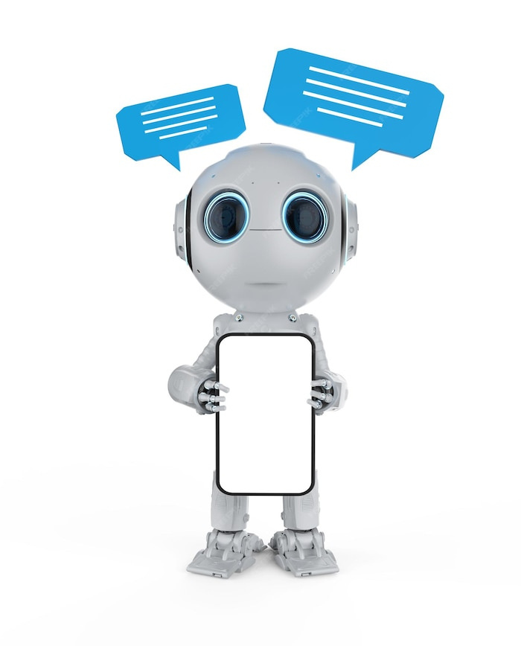
ENHANSING CUSTOMER
EXPERIENCE
By leveraging the power of IBM Cloud Watson Assistant and IBM Container Registry, businesses can enhance their customer experience. The AI capabilities of Watson Assistant enable chatbots to provide accurate and personalized responses, while the scalability and reliability of Container Registry ensure uninterrupted service availability.

Slide 8

REAL WORLD APPLICATION
The combination of IBM Cloud Watson Assistant and IBM Container Registry has numerous real-world applications. From customer support and e-commerce to healthcare and banking, businesses across industries can benefit from these powerful tools to deliver efficient and personalized chatbot experiences.

Slide 9
Containerize your application
Containerizing an application involves creating a container image that encapsulates your program and its dependencies, allowing it to run consistently across different environments.

Slide 10
CODING
Create a python application
“hello.py” script that prints “Hello, World!” when executed.
# hello.py
print(“Hello, World!”)

Slide 11
Create a Dockerfile
Create a file named "Dockerfile" (no file extension) in the same directory as your Python script.
# Use an official Python runtime as the base image FROM python:3.9
# Set the working directory within the container WORKDIR /app
# Copy the Python application code into the container COPY hello.py .
# Run the Python script when the container start
s CMD ["python", "hello.py"]

Slide 12
OUTPUT
You should see the “Hello, World!” message printed in the terminal.

Slide 13
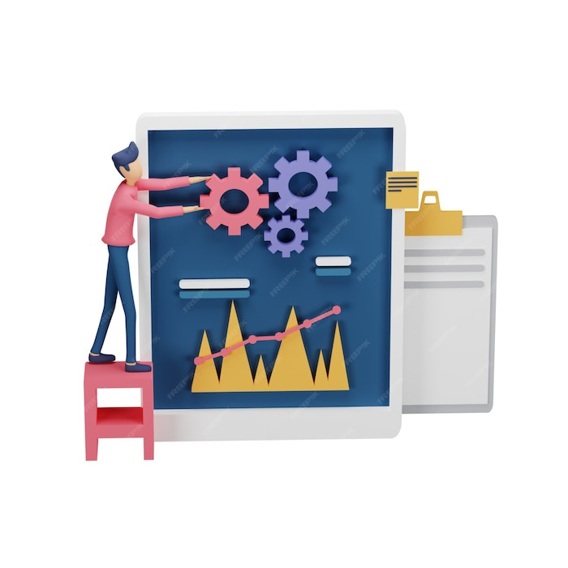
BEST PRACTICES
To make the most out of IBM Cloud Watson Assistant and IBM Container Registry, businesses should follow some best practices. These include proper training of the chatbot, continuous monitoring and optimization, regular updates, and leveraging the analytics capabilities to gain insights and improve the chatbot’s performance.

Slide 14

CONCLUSION
In conclusion, IBM Cloud Watson Assistant and IBM Container Registry provide a powerful combination for streamlining chatbot deployment. By leveraging these tools, businesses can enhance their customer support capabilities, improve operational efficiency, and deliver personalized chatbot experiences. Embrace the power of AI and containerization to take your chatbot deployment to the next level.

Slide 15


